Slide 1

Welcome to Year 6 Curriculum Evening

Slide 2

Our Aims
Work hard, always following our School Mission Statement- Learning to Love, Loving to Learn, Through Jesus
Get the children Secondary ready- develop independence and confidence
Prepare the children to feel confident in demonstrating their true capabilities in SATs in May
Have lots of fun and new experiences along the way

Slide 3
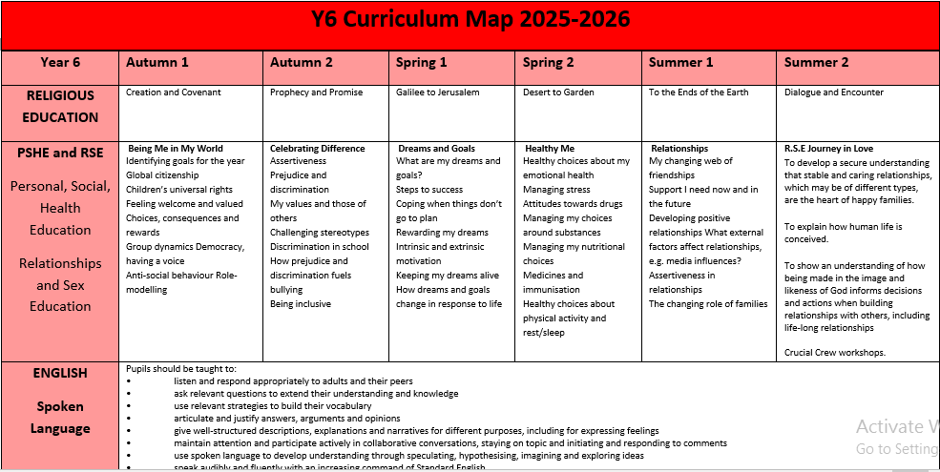
Curriculum Map
Outlines all topics covered and will be available on the school website

Slide 4
Attendance
Punctuality and attendance are high priority. Please book holidays and make dental appointments etc. outside of school hours.
Children may come into school from 8:30am. They should be present for the register being taken at 8:45am.
8:45am Registers open
If a child is late between 8:45 and 9:15am, they should come into school via the office and they will receive a late mark.
9:15am Registers close and any arrival after this time will be marked U - and it will count as an unauthorised absence.
10 unauthorised sessions (equivalent of 5 days) mean a penalty notice must be considered. The unauthorised lates count towards these 10 sessions.

Slide 5
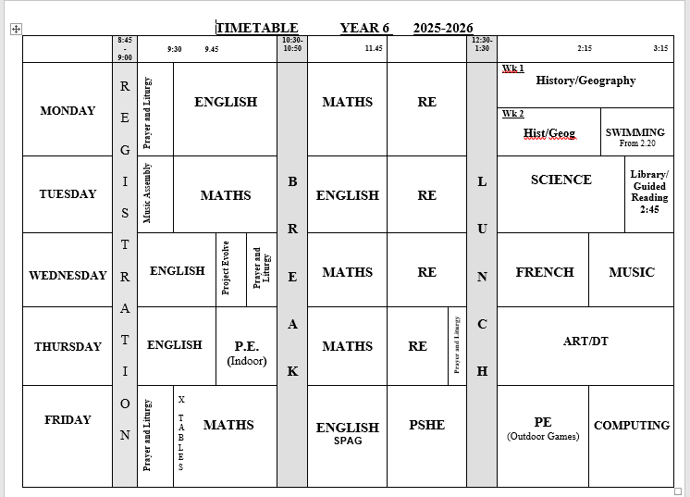
Timetable
PE kit in school every day please
Children have a copy on back of Homework/Reading record

Slide 6
Equipment
Pencil case with personal stationery items:
pens (not biros)
pencils
colouring pencils
eraser
sharpener
glue sticks
Art apron
Water bottle – not metal bottles please (health and safety)
PE kit- black/red shorts or skort, school red t-shirt, black or school tracksuit
Trainers
Packet of tissues
Coat every day especially important on swimming days
PLEASE NAME EVERYTHING!

Slide 7
Homework
Homework is given on Wednesdays. We will start this week.
Reading every night.
Maths homework will be due in on Mondays.
English will be due on Wednesday.
Spellings and Times Tables will be set each week and will be tested on Fridays.
The children will have a folder to take the work home and we will ask them to remove marked homework half-termly.
As well as weekly maths and English, we will occasionally set an extra piece as appropriate, which may be eg. a game to make, or history research etc.
One of the project pieces we usually set this term is a This is Your Life biography about a relative. More details will be sent out later but the children can begin thinking about who they would like to write about and gathering information.

Slide 8
Religious Education
We follow the new RED (Religious Education Directory) and are advised by the diocese. Our faith is at the heart of all that we do at St Thomas More. We have four formal RE lessons each week. We also have time to complete our prayer journals.
We have whole school assemblies three times per week. On the other days we will have prayer and liturgy in class and the children are given many opportunities to prepare and lead this themselves.
Relationship and Sex Education (RSE): Journey in Love. We follow the diocesan Journey in Love scheme, which is in keeping with our Catholic faith. We will send you an email to give further information and let you know when it is taking place in the summer term.

Slide 9
Reading
Reading is high priority. The reading framework produced by the DfE has an emphasis on helping children enjoy reading (reading for pleasure) from a broad range of books including different authors and genres.
Reading is the most important of all homework. Please hear your child read as often as possible.
Spend time discussing the book, as well as hearing read. Lots of inference questions in reading comprehension- not just lifting answers from the text e.g. ‘How do you know that…?’ or ‘What does the author mean by….?’
Reading record books are collected frequently to check children are reading at home regularly.
Children may bring books from home as long as they are checked by us first to ensure they are suitable.
Please sign reading record book with pages read each day.
We are really trying to promote the children reading at home every day. Children should read a page or two aloud to an adult and then there is an expectation for them to read on independently. It is vitally important to develop fluency and vocabulary.
Reading challenge: 6 books per term. Children collect stickers for each book read. Raffle ticket given when challenge completed with opportunity to win a class hamper at the end of term.

Slide 10
Writing
Writing is a big focus: different text types- reports, letters, plays, balanced argument etc.
paragraphs
advanced punctuation
description- metaphor, simile.
grammar- particularly the technical language
Two sessions per week we will split class for English.
Mrs Hall
Mrs Changer

Slide 11
Year 6 Prefects
These roles give the children a huge sense of responsibility.
Jobs rotate each term so everyone gets the opportunity to be a class prefect.
Children wear their badge with pride.

Slide 12
Chaplaincy Team
Children who are interested should write a letter setting out why they would like to be considered for the role. Letters should be handed in by Thursday 11th September.
Approx. 8 children
Promote Catholic ethos of our school
Lead some assemblies
Introduce statements of belief??
Organise some charity collections- Remembrance poppy appeal, Cafod, Brentwood children’s society
Prepare and deliver Advent and Lenten prayer trails

Slide 13
House Captains
Children have the opportunity to stand for House Captain. The other children vote for them following a presentation.
This will take place on Friday 12th Sept - children prepare a speech at home outlining their qualities and ideas.
Can do PPT if they wish.
Email it to year6homework@stmsw.co.uk

Slide 14
Sports Ambassadors
Children who are interested in being considered for this role should write a letter.
Again, letters should be handed in by Thursday 11th September.

Slide 15
School Council
Children elected will lead the school council in making changes to enhance every child’s experience at STM.
Children who are interested in being considered for this role should prepare a short presentation to deliver to their class.
This will take place on Thursday 11th September. Can do PPT if they wish.
Email it to year6homework@stmsw.co.uk

Slide 16
Clubs
Please encourage your children to represent the school and celebrate their talents by showing commitment to clubs.
Events and competitions can only take place if children attend regularly.

Slide 17
Visits/Visitors
Harry Potter Studio - Tuesday 23rd September, 2025
Leaving school at 8am
Returning at 6pm
Young Shakespeare - Fri 10th October
Year 6 Afternoon tea concert -
Victorian day - date tbc
Genome Campus - tbc
Crucial Crew – usually in June at a local venue (no cost)

Slide 18
Residential
Residential visit/
Centre is run by Cambridgeshire Education Authority.
You will receive a letter detailing costs and a payment schedule if you would like to pay in monthly instalments.
Activities can include kayaking, raft building, archery, mountain biking, climbing, sailing, Challenge and low ropes.
Last year, cost £315- should be similar to this.
A meeting will take place in the summer term- attendance at this meeting is essential.

Slide 19
Secondary Transfer
The application process for secondary school places opens on 12th September. You can apply online at www.essex.gov.uk
Open Evenings:
SWCHS Thursday 2nd October 4.30pm - 7.30pm
JFAN Thursday 11th September timings tbc
St Mary’s Bishop’s Stortford Wednesday 24th September 6pm - 8.30pm
Hockerill Saturday 13th September 8.45am - 12.30pm
You may need to book talks by the headteachers, which are usually at specific times during the open evenings.

Slide 20
Secondary Transfer
There is a national closing date for applications:
31st October 2025
NB You need to complete a SIF (supplementary information form) for Catholic Schools eg. St Mary’s.
Apply on one form to the County in which you live. If you live in Essex and apply to a Hertfordshire school, Essex will pass on the application to Hertfordshire county.
DON’T MISS THE DEADLINE or your application is treated as late and will only be processed after all the on-time applications.
Can apply online at www.essex.gov.uk
You will hear the outcome of applications on National Offer Day March 2nd 2026

Slide 21
Secondary Transfer
We have very good links with all of the secondary schools.
SWCHS have taster lessons/transition projects in summer term.
All schools have liaison visits and handover meetings with Y6 teachers.

Slide 22
SATs
Statutory Key Stage 2 tests
Dates: Monday 11th May – Thursday 14th May 2026
SPAG test - grammar, punctuation and spelling (45 mins)
Reading comprehension - 3 texts plus comprehension questions (1 hour)
Maths - formal arithmetic test (30 mins) and two problem-solving and reasoning maths tests (40 mins each)

Slide 23
SATs
No writing composition test- however, we have to submit our teacher assessment of writing to the DfE. So, writing across a range of genres is assessed by the class teacher. Writing levels may be moderated by an external moderator from the County. This usually happens once every three years.
The writing criteria is challenging and it is no longer ‘best fit’- children have to tick every box- including handwriting and spelling.
Science will also be teacher assessed (no formal test) and the results submitted to the DfE.
Children must not be away in test week unless there is an extremely valid reason.
It is also important that children do not miss days in the weeks prior to SATs as important revision work will be carried out. Therefore, please try to arrange dentist and doctor appointments outside of school hours wherever possible.
We will practise test technique during the year.

Slide 24
SATs
All pupils sit the same tests in maths and English.
The tests are marked externally and schools receive the results in July. We will report the results to parents on the school report.
Results will be reported as a scale score with 100 being the national average.
The table below shows the raw scores needed over the last few years to reach the expected standard:
 | 2019 Exp | 2019 GD | 2022 Exp | 2022 GD | 2023 Exp | 2023 GD | 2024 Exp | 2024 GD | 2025 Exp | 2025 GD
Maths (max 110) | 58 | 95 | 58 (53%) | 96 (87%) | 56 (51%) | 94 (85%) | 54 (51%) | 93 (85%) | 58 (53%) | 95 (86%)
Reading (max 50) | 28 | 41 | 29 (58%) | 41 (82%) | 24 (48%) | 38 (76%) | 27 (54%) | 40 (80%) | 28 (56%) | 40 (80%)
GAPS (grammar, punctuation, spelling) (max 70) | 36 | 55 | 35 (50%) | 55 (79%) | 36 (51%) | 55 (79%) | 35 (50%) | 53 (76%) | 35 (50%) | 54 (77%)
The raw scores are converted to scaled scores. Scaled scores of 110 are considered to be exceeding the expected level. The raw scores needed to achieve 100 may differ slightly from year to year to standardise the outcome, according to the difficulty of a particular paper.

Slide 25
SATs
The SATs are a snapshot; the Teacher Assessment takes into account the whole year’s work.
Important: Tests are timed (all of them) and the children will need to practise working to a time limit. Some homework may be timed.
To help the children with revision, encourage them to use the BBC Bitesize site for KS2. Later in the term, we will issue passwords for SPAG.com and Maths.co.uk websites. Also, after Christmas we will send home a revision pack with lots of support materials. The school is able to purchase the CGP revision books/practice papers at a reduced cost (approx. £12 for the set), so if you want to buy the books, it is cheaper to buy the school pack, rather than paying full price in the shops.
Use parental discretion to complete.
During the SATs year we maintain a broad and balanced curriculum. We will be doing some extra revision of maths and English in the latter half of the spring term. Some children will attend booster groups at various times to help support SATs preparation.
REVISION PACKS
We put these together and they are available to buy in January for around £12- half cost you would pay if you bought outside of school. Contain practice tests and revision guides.

Slide 26
Year 6 Souvenirs (optional)
Year Book approx £35 but may be less if we manage to get any sponsorship. (Cost for last year’s class was around £15 as we had very generous sponsorship.)
Hoodies - approx £25
We will take orders in advance for those who wish to purchase. Children can choose their own colour hoodie.

Slide 27
Awards
Ten awards available at the end of the year:
Mission
Citizenship
Sport
Music
Expressive Arts
Art
Curriculum
Maths
English
Kay Parfrey (effort, co-operation, obedience and perseverance)
Please let us know your views by emailing year6homework@stmsw.co.uk

Slide 28
AOB
Helpers (DBS checked)
Swimming
Alternate Mondays. Collect from pool at 3.30pm.
Thank you for permission emails. Please let us know any changes.
Birthdays
You may send birthday treats (cakes etc) from home, but no nuts and no sweets please.
Uniform
Please ensure your child sticks to correct uniform, particularly with regard to hair accessories, jewellery, socks. PE kit named on outside. Earrings should be removed- please provide a box for safe-keeping. Remember to bring coat on swimming day – weather can often change.

Slide 29
AOB
Amazon Wishlist- email will go out about this. If you are willing to contribute something to your child’s class, it would be very much appreciated.
PSA Class reps- support for the PSA very much appreciated.
Medical- if any changes please let the office know.
Worries/concerns
If you have any concerns, please don’t leave it until the situation is bad. Come and speak to us at the earliest opportunity (phone or email the office).

