Slide 1

Welcome to Year 1!

Slide 2

Agenda
The Year 1 team
Expectations
Behaviour
The Curriculum
Homework and Spellings
General school information - Kit, More News, Attendance etc.
Questions

Slide 3

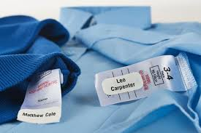
Expectations
We set high expectations for:
Uniform
Behaviour
Quality of work
We encourage children to:
Come into class independently
Organise their bags, reading books, and water bottles each morning
Take pride in their work and focus on neat handwriting
Select their own equipment (e.g., word banks, number squares)
Look after their own clothing and PE kit
Please ensure that all uniform items are clearly labelled.

Slide 4

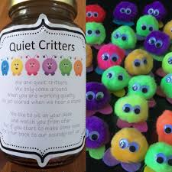
Behaviour
We believe in nurturing a supportive and encouraging learning environment through positive reinforcement.
Our strategies include:
🌟 Positive praise throughout lessons
🏅 Gold awards to celebrate achievement
🧼 Smelly stickers as fun motivators
🐾 Quiet Critters to encourage calm and focused learning

Slide 5
Curriculum
Moving into Year 1 is a big step, and it comes with new expectations as children transition from the Early Years Foundation Stage.
The Year 1 National Curriculum:
  Core Subjects: English, Maths, and Science
  Foundation Subjects: History, Geography, Art, D&T, Music, Computing, PE and PSHE
  RE
More information about what we cover in Year 1 can be found in our curriculum map on the school website.

Slide 6

RE
We follow the Religious Education Directory for Catholic schools.
Focus on knowing, understanding, and living the Catholic faith.
Explore key stories from the Bible.
Learn about prayer, liturgical seasons, and Catholic values.
Opportunities for reflection, kindness, and spiritual growth.

Slide 7

English
Reading:
Develop phonics knowledge
Decode unfamiliar words using phonics
Read common exception words (e.g., "said", "the")
Discuss stories, poems and non-fiction texts
Begin to make simple inferences
Writing:
Spell words using phonics
Use capital letters, finger spaces and full stops
Write coherent sentences and short stories
Begin to use conjunctions (e.g., "and")
Form letters correctly
Speaking & Listening:
Speak clearly in full sentences
Listen and respond appropriately
Take part in discussions and performances

Slide 8
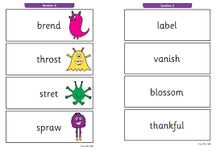
Phonics
Revisit and consolidate phase 3 and phase 4 and develop a secure knowledge of phase 5
Read and spell words with alternative spellings for known sounds
(e.g., ai, ay, a-e all make the same sound)
Recognise and use grapheme-phoneme correspondences - matching written letters (graphemes) to their corresponding sounds (phonemes)
Read real and alien words confidently
Blend sounds to read unfamiliar words
Segment words to support spelling
Assessment:
Prepare for the Phonics Screening Check in June
Some useful online resources:
Phonics Play – although there is a charge of £12 per year
Geraldine the Giraffe and Mr Thorne Does Phonics

Slide 9

Reading
How You Can Help with Reading:
Read daily at home with your child
Aim for 10 minutes of reading each day
Discuss the book together to improve understanding
Record progress in the reading record
Daily reading makes a significant difference to their progress
Don’t worry if the book is one your child has already read—this helps develop fluency
Encourage your child to take care of their book to keep it in good condition

Slide 10

Maths
Maths Curriculum in Year 1
We use Primary Stars to support the delivery of our maths curriculum.
Key themes we will cover:
Number and place value up to 100
Addition and subtraction within 20
Shapes, patterns, and simple measurements
Problem solving and reasoning
Useful resource for home: 1-Minute Maths
This is a great tool to build confidence with quick, daily maths practice

Slide 11



Other Subject Highlights
Science:
Seasonal changes including weather reports
Animals including humans and our ‘Tweet of the Week’
Plants
Everyday materials
History:
Gunpowder Plot
Castles
Toys
(Parent/Grandparent input welcome for toys!)
Geography:
Continents and Oceans
Global Connections:
(If your child has family or friends living overseas, they can share their location, and we’ll find it on the map!)

Slide 12

Homework
Sent home on Wednesday and handed in on Monday
Always completed in pencil
Encourage your child to be as neat as they can and present their homework carefully
Help as required – it’s a great opportunity for one-to-one time with your child

Slide 13

Spellings
Spellings can be found in the front of the children’s homework book
Spelling check takes place on Monday
Little and often is best for spelling practice—also a great opportunity for handwriting practice
Spelling test results will be noted in the homework books (if books are handed in on the Monday)

Slide 14

Uniform
Label all uniform clearly
Book bag – small
Pencil case – small (optional)
Plastic water bottle – brought in daily with fresh water (please do not put in book bags to avoid spills)
Glue sticks

Slide 15

PE Kits
PE on Monday, Tuesday, and Thursday
PE kit should be in school every day
Label kit and bags on the outside for quick identification
No earrings during PE lessons
We encourage children to be as independent as possible
If wearing tights, please pack socks in the PE bag for use with trainers (labelled)
If PE kit is forgotten, unfortunately, your child will be unable to participate in the lesson

Slide 16
More News
Please remember to read More News each week as it always has important dates and school information.
We try to keep emails to a minimum by putting information on More News whenever possible.
As well as being emailed to you weekly, it is also available on the website.

Slide 17
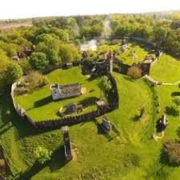
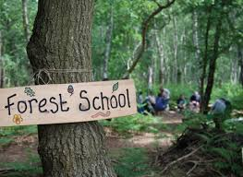

Trips and Visits
Mountfitchet Castle – March TBC
Radwinter Dance Festival – March TBC
Our Lady of Compassion
Forest School –s in July TBC (approx £35)

Slide 18

Medical
Please ensure we are aware of all medical plans and requirements for your child.
Any medication must be handed into the office—children cannot bring it to class.

Slide 19

Attendance
Increased focus on attendance: The Department for Education has introduced a national framework that all schools in England must follow.
If a child accumulates 10 unauthorised sessions (equivalent to 5 days), a penalty notice may be considered.
Late Arrivals:
Children can arrive from 8:30 am, but must be present by 8:45 am when the register is taken.
After 9:15 am, registers close, and any late arrival will be recorded as an unauthorised absence.

Slide 20

Parent helpers
We are always grateful for any help.
Where possible, please do let us know beforehand.
All helpers will need a DBS check.
PSA class reps are a wonderful way to get involved with raising much needed funds for the school.

Slide 21
Any Questions?

